Slide 1


Michael Vizelman
Capstone Presentation
Generation Z
The Young and The Restless
Sara
Ferrari
Summer 2020

Slide 2






Gen-Z as future customers
Overview
Background
Goal
Project Stages
Data
Models
Visualizations
Key Findings

Slide 3

Background
Gen-Z members were born between 1997-2012 (8 – 23 in 2020)
Gen-Z US population is currently 67 million people (out of 330 million)
By 2040 Gen-Z will be the largest cohort alive and will comprise the largest portion of the labor force

Slide 4

Goal
The goal of this project was to predict the income class of a Gen-Z individual based on demographic data such as age, sex, marital status, education industry, residence region, etc.
This information could be valuable for marketing and targeting purposes. Relevant industries could include retail, services, universities, and other organizations.
We will also visualize interesting findings based on our data sample.

Slide 5



Stage 1
Stage 3
Project Stages
Data Collection, Preparation, and Analysis
Visualizations
Stage 2
These were the high-level stages of our capstone project
Model Creation, Evaluation, Selection

Slide 6

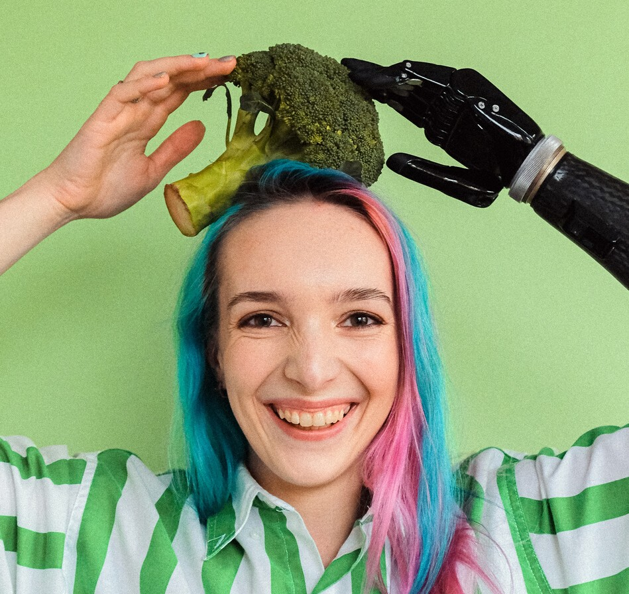
Data
We used data from the 2019 Census Current Population Survey
54,000 households were selected to be interviewed based on area of residence to represent the nation.
Data Preparation:
Combine personal and household features
Isolate Gen-Z members older than 15 and living independently
Remove Gen-Z members that are children or not in labor force (NILF)
Final amount of observations - 2,149
Generate income classes (Lower, Middle, Upper) based on the median household income of the sample
Gen-Z Income Ranges
Lower – under $40K
Middle - $40 -$120K
Upper – over $120K

Slide 7


Data
Data Analysis:
Side-by-side bar-plots against the target
Chi-square test between categorical predictors and categorical target
Information gain from each of the explanatory categorical variables
Variables chosen for ML models:
state, industry, education level, sex, earning source, marital status, and age

Slide 8


Models
We created 5 different Classification Models to predict the income class of a Gen-Z individual.
We then evaluated the performance of the Models on Train and Test subsets.
We looked at improving accuracy. Since we balanced the classes in our dataset, the accuracy of a naive model would be 33%.
Multinomial Logistic Regression
K Nearest Neighbors
(KNN)
Performance
Train Accuracy: 85%
Test Accuracy: 60%
Performance
Train Accuracy: 76%
Test Accuracy: 60%

Slide 9



Decision Tree
Random Forest
Ensemble (Stacking)
Performance
Train Accuracy: 83%
Test Accuracy: 60%
Performance
Train Accuracy: 85%
Test Accuracy: 72%
Performance
Train Accuracy: 88%
Test Accuracy: 78%

Slide 10
Model Evaluation Metrics - Training and Testing Sets
Train
Test

Slide 11
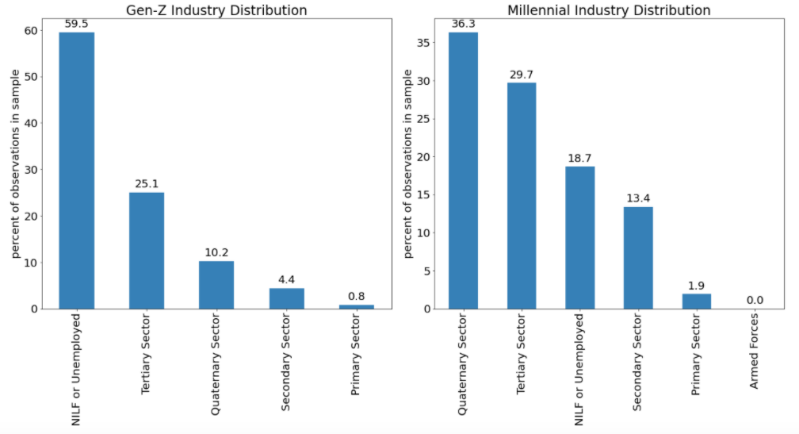
Industry Distribution - Gen-Z vs. Millennials
Primary Sector: extraction and harvesting of natural resources such as agriculture and mining.
Secondary Sector: construction, manufacturing, and processing. Industries that relate to the production of finished goods from raw materials.
Tertiary Sector: retailers, entertainment, and finance. Companies that provide services to consumers.
Quaternary Sector: knowledge or intellectual pursuits including research and development (R&D), business, consulting services, and education.

Slide 12
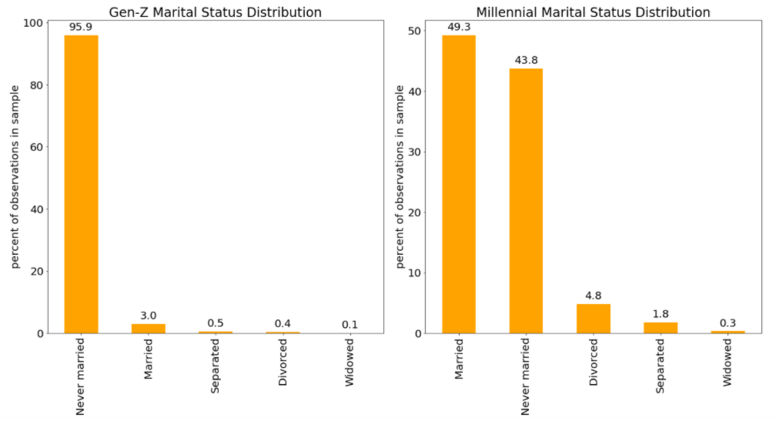
Marital Status Distribution - Gen-Z vs. Millennials
Marital Status Classes
Never married
Married
Separated
Divorced
Widowed

Slide 13
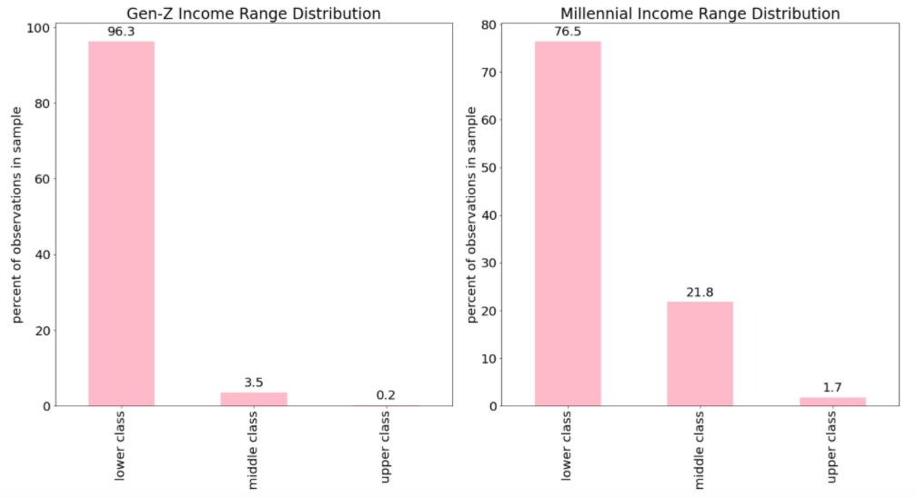
Income Range Distribution - Gen-Z vs. Millennials
Income Ranges
Gen-Z
Lower – under $40K
Middle - $40 - $120K
Upper – over $120K
Millennial
Lower – under $60K
Middle - $60 - $180K
Upper – over $180K

Slide 14

Summary and Key Findings
Working Gen-Z members are mostly part of the Tertiary Sector (provide services to consumers).
4% of Gen-Z members (age 15-22) were married, and 25% of them are already not married.
Most of Gen-Z members are still in the lower class of income range (under $40K).
Somewhat surprisingly, the results showed that sex and marital status are still significant variables in determining an individual's income.
We believe the best model for achieving the goal of this project would be an Ensemble model comprised of KNN, Decision Tree, and Random Forest models.
In order to further improve the accuracy we achieved, we would need more observations, more data points, a more sophisticated model, or a combination of these.

Slide 15

Thank you! Questions?

